Slide 1
Forecasting
Saran Ishika Maiti

Slide 2

Can you recognize?

Slide 3
About Bob
Robert Shiller----- The Forecasting Man.
Professor of Economics At Yale
Bob Got Nobel in 2013.
He authored many best selling books---one such book is’ Irrational Exuberance’.
He first predicted in 2005 that Financial crisis is coming. Stocks are extremely overvalued. Housing prices are unrealistically high. Market will Collapse.

Slide 4
BOB is Remarkable
Nobody was ready to accept his prediction including the people operating in Wall street.
In 2008, USA faced severe financial crisis.
Stock market, housing market crashed.
‘Lehman Brother’---- a company of 100 years with the most intelligent management and most intelligent employee got bankrupt in 2008

Slide 5
Bottom Line
Correct forecast can save million/billion/trillion dollar
Forecast can make you Millionaire/Billionaire/Trillionaire

Slide 6
Anecdote
Bob was asked whether he will get Nobel or not.
His categorical answer was ‘NO’.
Bob failed to predict his own fortune!!

Slide 7
Bottom line
It is extremely difficult to predict rare/extreme events. Getting Nobel is one such extreme event.
Earthquake, Tsunami are such example of extreme events.
We will not cover forecast of such extreme events.

Slide 8
Need for forecasting
Forecasting is the process of making predictions of the future based on past and present data and most commonly by analysis of trends.
Why forecast, when you would know the outcome eventually?
Early knowledge is the key, even if that knowledge is imperfect
For setting production schedules, one needs to forecast sales
For staffing of call centers, a company needs to forecast the demand for service
Every years. Government’s budget is based on predicted values of Revenue income.

Slide 9
It is our innate dream to know our future.
We go to Astrologer to know our future health, love line, pass-fail in exam and so on. Worldwide it has few billion dollar market.
Forecast by astrologers are not scientific!
Our forecast are scientific!. By scientific forecast we mean, forecasts come with SE, CI. Mathematically we can prove that our forecast will lie within an interval with pre specified confidence level.

Slide 10
Types of forecast
Short term=<20yrs/30yrs years
Macro forecasting is concerned with forecasting markets in total. This is about determining the existing level of Market Demand and considering what will happen to market demand in the future.
Micro forecasting is concerned with detailed unit sales forecasts.
A forecast can be
Short term or long term
In a micro or macro scale
Qualitative or quantitative
Based on data or judgement
Meant for projecting
A single number (Point forecast)
A range of numbers (Interval forecast)
A probability density function (Density forecast)

Slide 11
Forecasting steps
Problem formulation and data collection
Data manipulation and cleaning
Model building and evaluation
Model implementation to generate forecast
Forecast evaluation

Slide 12
Considerations for choosing a forecasting method
Purpose of forecast
Available data
Type of forecast
Time needed/available
Cost involved

Slide 13
Key issues in managing a forecasting process
Why is the forecast needed?
Who will use the forecast, for what purpose?
What level of detail/aggregation is needed?
What data are available?
What will the forecast cost?
How accurate is the forecast expected to be?
Will the forecast be available in time?
Does the forecaster understand the need of the organization?
Is there a feedback process to evaluate the forecast and adjust the forecasting process?

Slide 14
Cost of Forecast
There are two type of Costs; (1)Direct cost; and (2) Indirect cost.
Direct cost: Expert cost/consultant cost, data collection cost, hardware and software cost etc.
Indirect cost is difficult to measure. The cost/loss of giving wrong forecast could be enormous.
Indirect costs are not directly accountable to a cost object, example telephone expenses, security expenses, legal expenses etc.

Slide 15
Two Different Approaches
Old/Classical/Traditional Approach (Like moving average, exponential smoothing)
Modern/Stochastic Process Approach ( like ARIMA, VARMA)
It is not that modern approach is better than the classical approach.
Looking into the same time series from different perspective. It may be
OLD IS GOLD.

Slide 16

Forecast error
Forecast error is
If model is adequate, forecast error should contain no information
Plots of e_{t} should resemble that of ‘white noise’ or uncorrelated random numbers with 0 mean and constant variance
(There should be NO PATTERN).

Slide 17
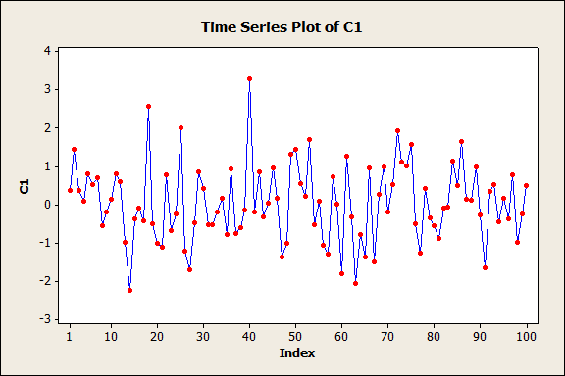
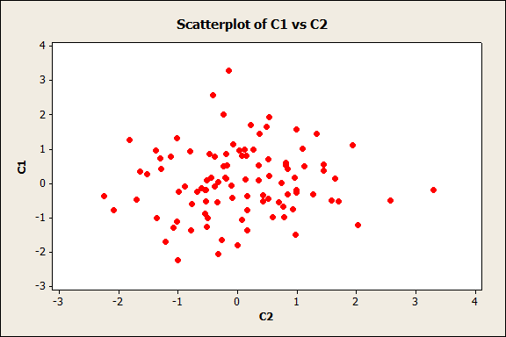
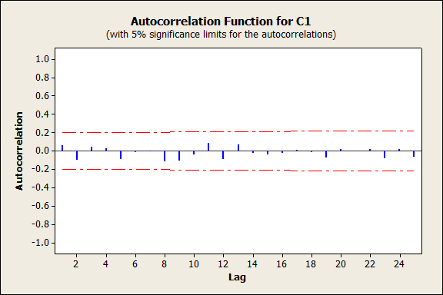
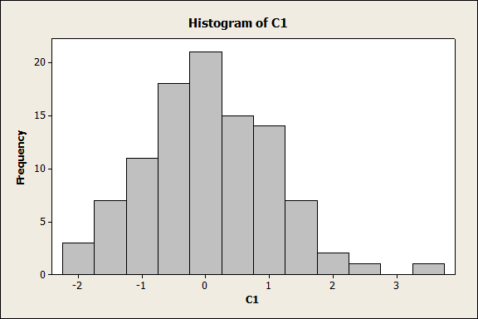
Typical plots of ‘white noise’
Time plot
Lag plot
ACF plot
Histogram

Slide 18
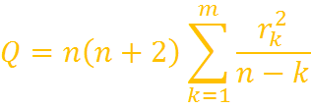
Formal test for checking randomness
Portmanteau test (Ljung-Box) on ACFs of the residuals:
Q has to be compared with cut-off of chi-square distribution with m degrees of freedom.
If it is smaller than the cut-off, the residuals can be said to be random.
In R the command is
Box.test(x, lag=1)

Slide 19

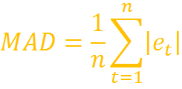
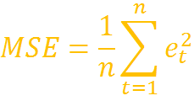
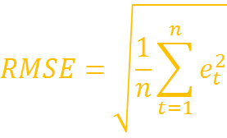
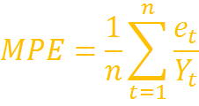
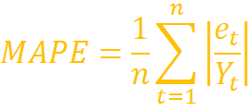
Summary measures of forecast error (for comparing models)
Mean error
Mean absolute deviation
Mean squared error
Root mean squared error
Mean percentage error
Mean absolute percentage error

Slide 20
Mean error (ME)
If the ME is around zero, forecasts are called unbiased. Model is unbiased to overestimation or the underestimation. Certainly this is a desirable property of a model.
Actual data | Forecast based on Model 1 | Error from model 1 | Forecast from model 2 | Error from model 2
100 | 101 | 1 | 110 | 10
200 | 199 | -1 | 190 | -10
300 | 301 | 1 | 310 | 10
400 | 399 | -1 | 390 | -10
ME |  | 0 |  | 0

Slide 21
Mean error
Mean error has the disadvantage that small amount and large amount of error may have same effect.
To overcome this problem we may define two different forecast performance measure.
1. Mean Absolute Deviation:
2. Mean Square Error:

Slide 22
MAD and MSE
For some data set, assume:

Slide 23
Problem with ME, MAD, MSE
All these three measures are not unit free and also not scale free.
Just think of a case that one is forecasting sales figures. Someone in India using rupee figure, and somebody else in USA the same sales figure expressed in dollar. Both are using the same model. However forecast measure will differ. This is a very awkward situation.
MSE has the added disadvantage that its unit is in square. RMSE does not have this added disadvantage
So we need unit free measure.

Slide 24
MPE and MAPE---Unit free measure
Both expressed in percentage form.
Both are unit free

Slide 25
Advantage of ME and MPE
Non-zero value of ME and MPE suggest that model does not produce unbiased forecast.
Positive value of ME and MAPE suggest that model does under prediction.
Negative value suggests over prediction.

Slide 26
Forecasting software
We will use
MS-Excel
R
Other options
Other general purpose software (SAS, SPSS, STATISTICA, SYSTAT etc.)
Specialized software (Autobox, Forecast Pro, ITSM etc.)

Slide 27
Transformation of Data

Slide 28
For several reasons, sometimes we need to take log transformation of the original variables for the following reasons:
To reduce the impact of extreme observations, to reduce degree of heterogeneity (variance stabilization).
Original data may be far from normal distribution, log transformed data may be quite close to the normal distribution.
Note 1: Logarithmic transformation is statistically appropriate if the plot of the sequence of standard deviations to arithmetic means is proportional in nature.
Note 2: It has, in general, been found that usual macro variables except rate variables like interest rate, employment rate etc., are amenable to logarithmic transformation.

